Slide 1
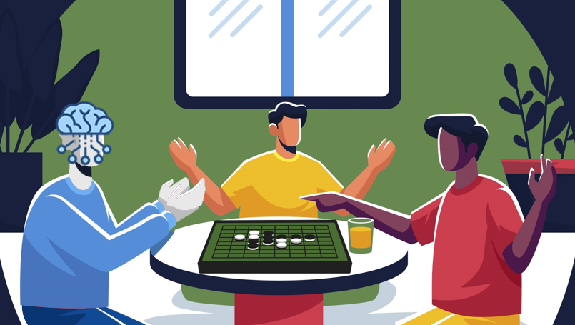
Deep Learning in Othello games Dissertation
“LUCIAN BLAGA” UNIVERSITY OF SIBIU
ENGINEERING FACULTY
Specialization: Advanced Computing Systems
Coordinator: Conf. dr. ing. Morariu Daniel
Graduate: Bărbulescu Adrian

Slide 2
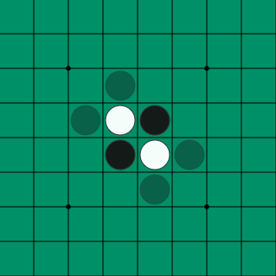
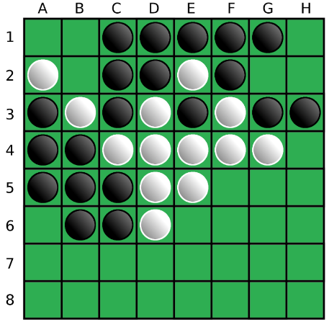
Introduction
What is Othello? A Shakespeare inspired game?
Sort of, Othello, also called Reversi, is a strategy board game for two players, played on an 8×8 uncheckered board. The name was selected by Hasegawa as a reference to the Shakespearean play Othello, the Moor of Venice, referring to the conflict between the Moor Othello and Iago, and more controversially, to the unfolding drama between Othello, who is black, and Desdemona, who is white.
Notes:
What is Othello? A Shakespeare inspired game?
Sort of, Othello, also called Reversi, is a strategy board game for two players, played on an eight by eight uncheckered board. The name was selected by Hasegawa as a reference to the Shakespearean play Othello, the Moor of Venice, referring to the conflict between the Moor Othello and Iago, and more controversially, to the unfolding drama between Othello, who is black, and Desdemona, who is white. It was invented in one thousand eight hundred and eighty-third.
The rules of the game are pretty straightforward, the game traditionally begins with four discs placed in the middle of the board, two for white and two for black player. Black moves first. Black must place a black disc on the board, in such a way that there is at least one straight (horizontal, vertical, or diagonal) occupied line between the new disc and another black disc, with one or more contiguous white pieces between them.
After placing the disc, Black flips all white discs lying on a straight line between the new disc and any existing black discs. All flipped discs are now black. Now White plays. This player operates under the same rules, with the roles reversed.

Slide 3
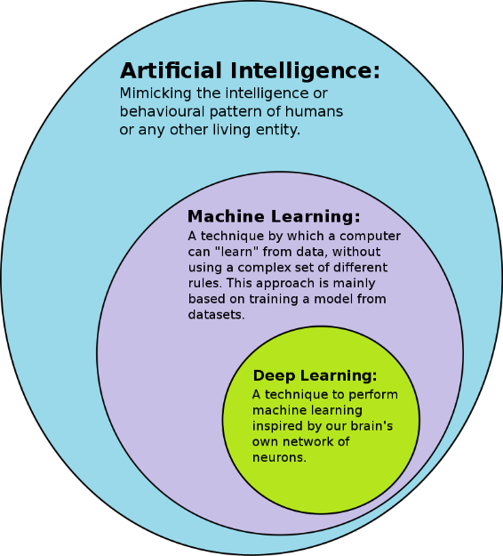
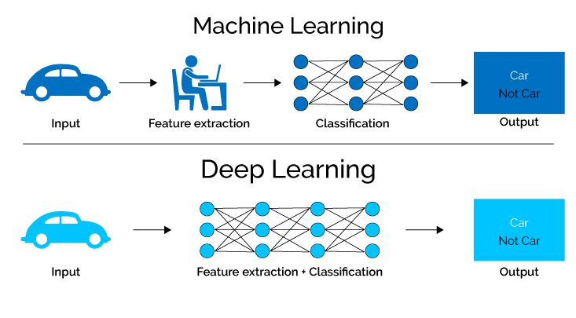
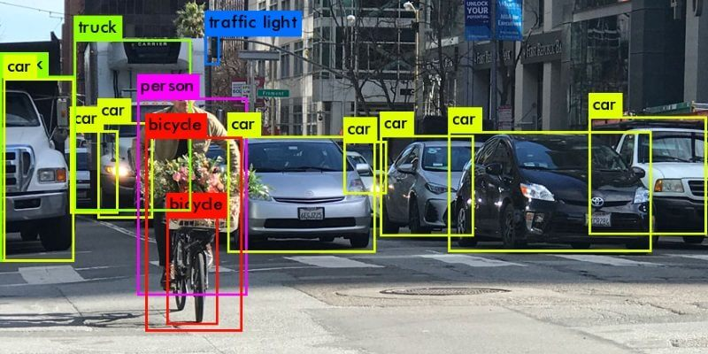

Introduction
Deep Learning
Deep learning (also known as deep structured learning) is part of a broader family of machine learning methods based on artificial neural networks with representation learning. Learning can be supervised, semi-supervised or unsupervised.
Convolutional neural networks (CNN/ConvNet)
Most modern deep learning models are based on artificial neural networks, specifically convolutional neural networks (CNN).
Notes:
Deep learning (also known as deep structured learning) is part of a broader family of machine learning methods based on artificial neural networks with representation learning. The adjective "deep" in deep learning refers to the use of multiple layers in the network.
Deep learning, the sub-class of machine learning, are used in many domains and have a broad set of applications in the real world like: image recognition, recommendation systems, mobile advertising and others.
Most modern deep learning models are based on artificial neural networks, specifically convolutional neural networks. Convolutional neural networks are regularized versions of multilayer perceptrons. Multilayer perceptrons usually mean fully connected networks, that is, each neuron in one layer is connected to all neurons in the next layer.
In this paper, I will present a state of the art deep learning method (that uses a convolutional neural network), combined with a stochastic method, implemented in an online self-playing system that will try to play & win against a computer opponent in the board game “Othello”.

Slide 4
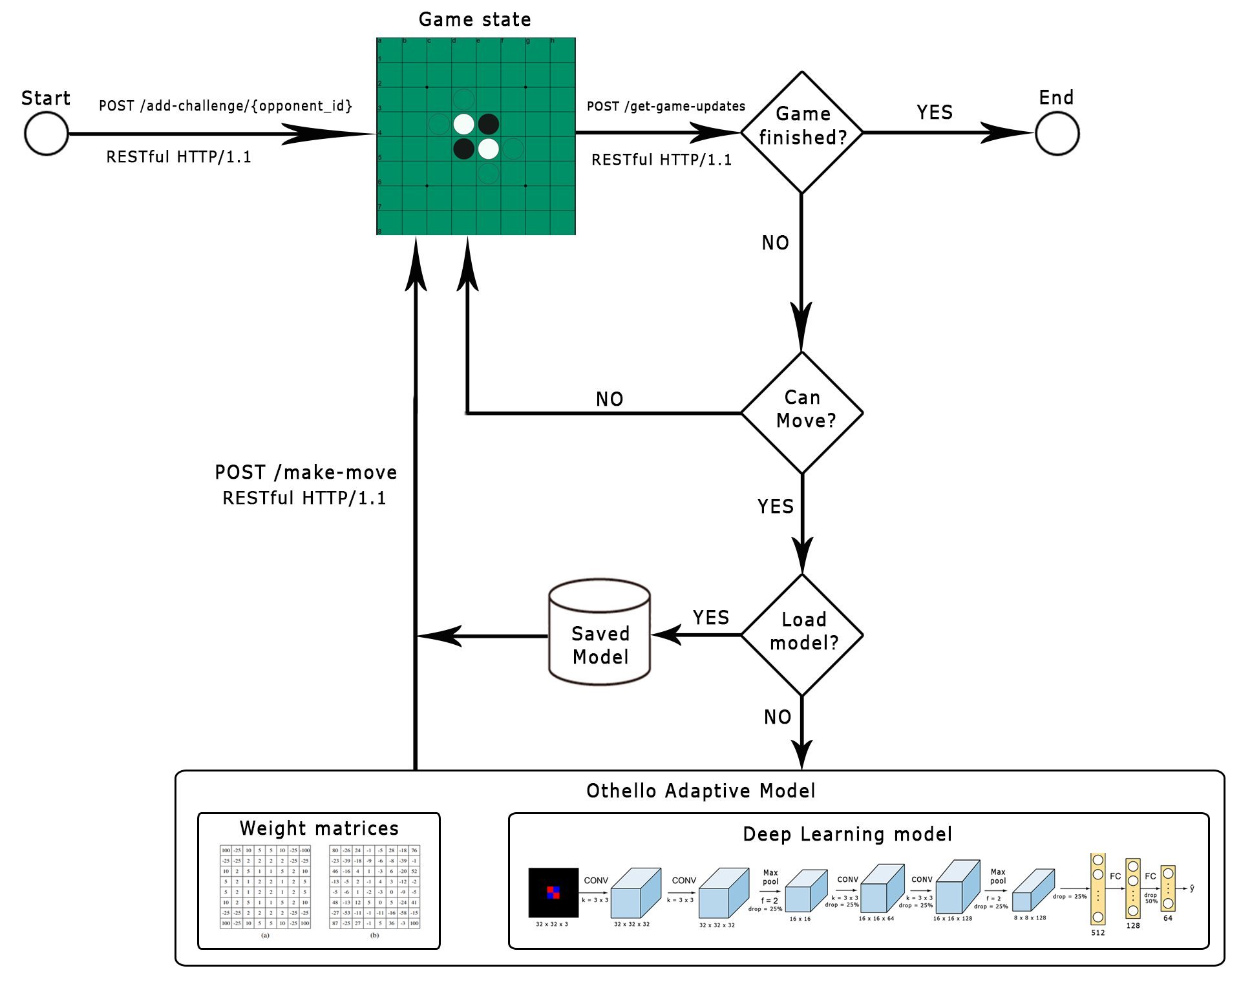

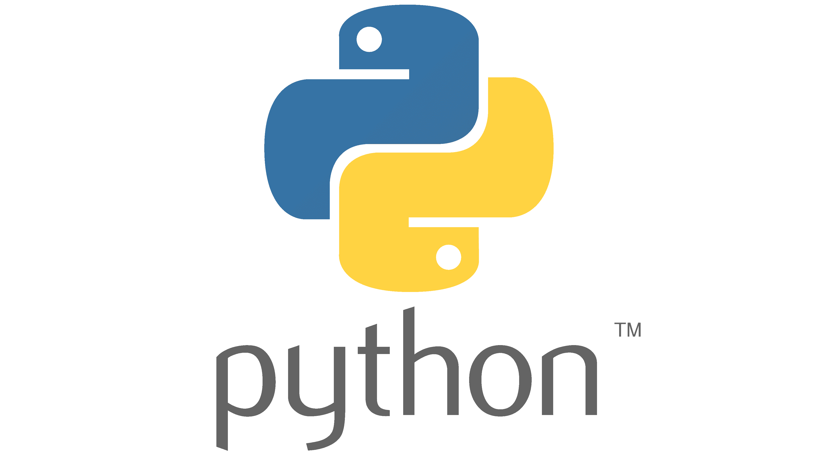

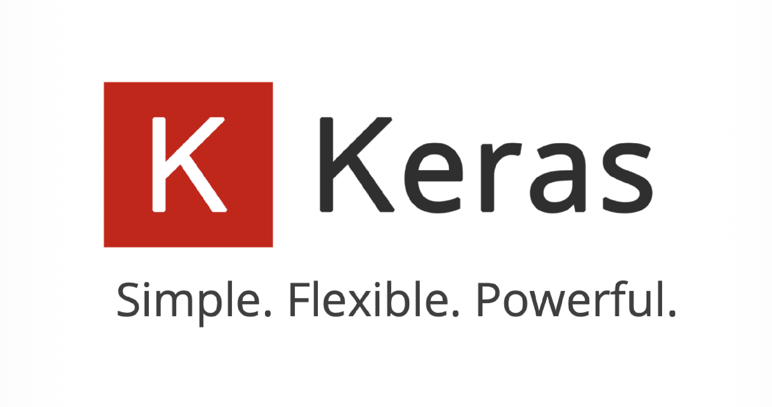
Architecture
The Adaptive model contains 2 sub-models:
The predefined weight matrices/tables
The deep learning model
Tools used:
Notes:
It can be seen in this figure that the system is mainly structured around the Othello Adaptive Model and it uses three RESTful POST API requests to simulate the game on eothello dot com.
The adaptive model presented here uses two sub-models combined and saved in memory:
- The predefined weight matrices/tables which uses saved tables in memory to decide which move to take
And The deep learning model
The main program is implemented in Python version three dot eight, using the Requests HTTP Library for the RESTful API requests, Tensorflow and keras for the Deep learning model, numpy for working with matrices and matplotlib for visualizing different data & statistics from the game
In the following slides, I will present all the techniques implemented for the this adaptive system.

Slide 5
Dataset
The deep learning model uses a collection of datasets from different sources for the learning process. The datasets are the following: a csv file from Kaggle with over 10000 games hosted on eothello, a dataset containing matches between professional Othello players and a dataset of matches played by our implementation of the adaptive model.
Example of a registered match in the pro matches dataset in the XML format:
<game-collection>
<game>
<event date="2004-05" name="yahoo japan"/>
<result winner="black" type="normal">51-12</result>
<player color="black" name="seeley ben"/>
<player color="white" name="suekuni makoto"/>
<moves game="othello-8x8" type="flat">f5d6c3d3c4f4c5b4c6e6f6b3a4g6g5h6e3f3g4h5h3g3e2d2d1c1b1e1f1c2f2e7d7f7e8b6b5a3a5a6f8c8d8g8h2c7b7g2b8a8a7g1h1h4b2a2a1g7h7</moves>
</game>
....
<game-collection>
Notes:
The deep learning model uses a collection of datasets from different sources for the learning process. The datasets are the following: a csv file from Kaggle with over ten thousand games hosted on eothello, a dataset containing matches between professional Othello players and a dataset of matches played by our implementation of the adaptive model.
When saving the information from the datasets, we are only parsing the result winner attribute (which can be black or white or draw) and the moves field text (which is a full string of symbols representing the cell in the board with a notation similar to chess), disposing the other redundant fields.

Slide 6
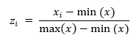
Pre-Processing
Preprocessing is the process by which data is cleaned and normalized, this being the most important step in a project working with machine learning algorithms.
Lack of this process can make the learning process difficult and can negatively affect the quality of the results, often the learning algorithm returning false results without a pre-processing step.
Normalization
In the simplest cases, normalization means adjusting values measured on different scales to a notionally common scale, often prior to averaging.
Notes:
Preprocessing is the process by which data is cleaned and normalized, this being the most important step in a project working with machine learning algorithms. Lack of this process can make the learning process difficult and can negatively affect the quality of the results, often the learning algorithm returning false results without a pre-processing step.
This method implements file parser functions for different dataset formats, makes conversion between the in-program table board and the board from the eothello dot com website, and other methods.
Another process in the pre-processing phase is the normalization step. In the simplest cases, normalization means adjusting values measured on different scales to a notionally common scale, often prior to averaging. We use normalization for the prediction phase in the predefined weight matrices model with the equation presented here.

Slide 7
Game API methods
3 REST API methods used to play on eothello.com:
Add a challenge
HTTP/1.1 – POST/add-challenge/{player_id}
Creates a game on eothello with the playerid specified in the request endpoint path.
Returns a game_id parameter.
Get game updates
HTTP/1.1 – POST/get-game-updates
Body format: game_id={X}&last_board_moves={Y}&last_chat_message_id=-1
This method allows the player to receive update about the state of the game.
Returns the server time, the turn for the player who should move, the winner if exists, empty otherwise, the previous moves played and the next update in milliseconds.
Make a move
HTTP/1.1 – POST/make-move
Body format: game_id={X}&move={Y}&move_index={Z}
This method allows the player to make a move on the board.
Returns the color of the player who has to move for the current turn.
Notes:
For our adaptive systems, we use three rest request methods to play a game on eothello dot com against another computer player implemented by them.
The first method, add a challenge, creates a game on eothello with the playerid specified in the request endpoint path. This request returns a game_id parameter to be used for the other requests.
The second method, get game updates, allows the player to receive update about the state of the game. This request returns the server time, the turn for the player who should move, the winner if exists, empty otherwise, the previous moves played and the next update in milliseconds. It also uses the body format described here where game_id is the parameter returned from add a challenge request and the last_board_moves is the string of moves with the Othello notation until that point.
The last method, make a move, allows the player to make a move on the board. This request only returns the color of the player who has to move for the current turn.
Using these methods, we have all the necessities to play a game on their website using their API.

Slide 8
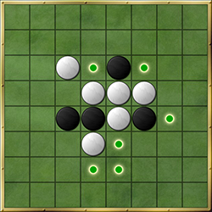
Game rules
Things to consider on implementation:
Check the validity of a move based on the empty space or the enemy disk
Check all 8 directions for a valid move
Change the disk/s color correctly when captured
Save all the valid moves
Notes:
I have explained the rules of the classical mode in Othello and how a player can make a move on board and capture the opponent disks. The main idea here is that the a piece should look in all of it’s eight directions (up, down, left, right, diagonals upper-left, upper-right, lower-left, lower-right), if there is no piece there, then the player can not move in that direction, if there is a piece it will need to look forward in that direction until it finds a new empty space, if there is an empty space in that direction and the previous piece is of opposite color, the player will capture the empty space and all of the pieces in that direction and change their color to the player’s color, if the previous piece color is of the same color, then the player can not place a piece in that empty space. When looking for valid moves, we need to search every self color piece with the condition stated before and adding them to a set of valid matrix positions. We use a set to avoid adding the same position in the valid moves list.

Slide 9
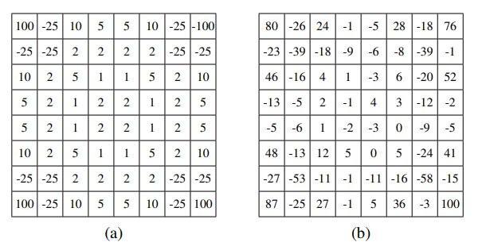
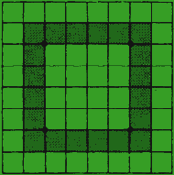
The Predefined Weight Matrices Model
Dangerous zones to place a disk (dark green):
a) Heur, b) Bench weight matrices
Notes:
The main of idea of this model is based on taking into the account the ways we can win at the board game Othello. Capturing the corners ensures us that the corner disks are safe from being captured. Although, capturing the corner is safe, all the positions near the corners are very dangerous to place a disk on there, this will ensure that the other player can then place a disk on the corner, thus capturing the near-corner disks.
Taking all these points into account, a team of researchers came with two performant tables that solves the problem of thinking on where is the best move to take on board, based on a value on that position called weights, positive weights representing a higher bias for the win and negative values representing the higher change of losing when placing the disk in that position. These tables are called Heur & Bench matrices.
Although, these tables are different, they are both reduced to the main idea, prioritizing the corner, avoiding the dangerous zone and playing a strategical game of controlling the middle.
The values from the tables are normalized when implemented based on the formula presented on the normalization slide.

Slide 10
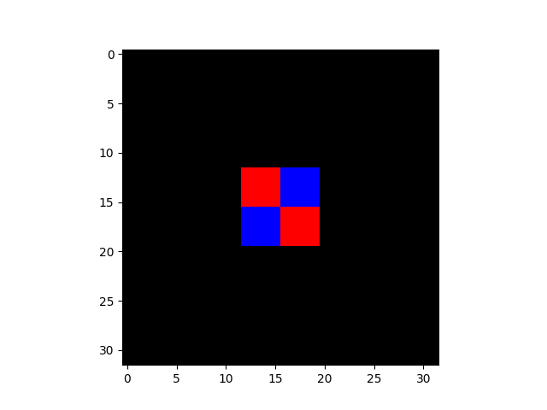
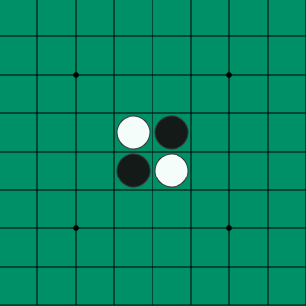
Learning Model Setup
Initial Othello board setup (plotted as a NumPy array):
Initial Othello board setup:
Learning values setup:
model_type='4conv-layer’,
batch_size = 32,
epochs = 25,
max_loaded_matches = 3000,
split_validation = 0.8
optimizer = keras.Optimizers.Adam()
Notes:
Using a CNN based architecture proved to return good results when comparing to a simple stochastic method, using multiple convolution layers with max pooling layers enhance edges and emboss the image, maximizing every detail in the image that will be the board.
For the deep learning model to learn and function, we need to feed it an input image of the size specified beforehand. The image can be a numpy double dimension array, that contains a three value array which represents the color channels for red, green and blue. We implemented the disk color of white as red, the disk color of black as blue and the empty board as black for the numpy array, shown in this figure.
Before using this model, we also need to think of the predefined learning values used in the training phase, for example the batch size, the number of epochs and other parameters. We created a config file with the parameters presented here.

Slide 11
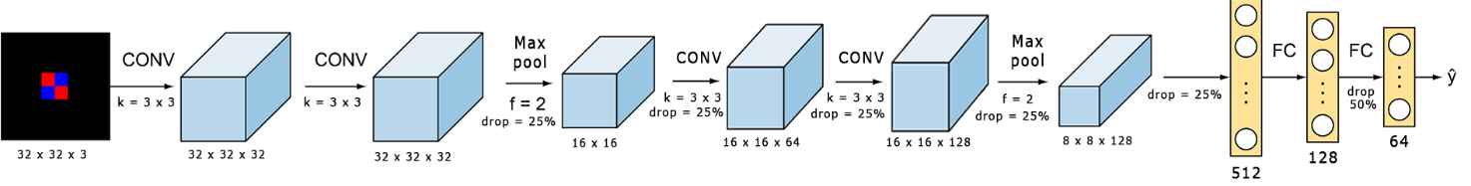
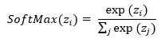
The Deep Learning Model (ConvNet)
Activation functions:
Notes:
In this figure, we can see the deep learning model implemented in the adaptive system.
We can see that the input image is a numpy double array with the size of thirty two for height and width, followed by two convolutional layers with thirty two filters and a kernel size of three. Following the convolutional layer, there is a max pooling layer with a size of two, followed also by two convolutional layers, first with sixty four filters and the next having one hundred twenty eight filters. The final convolutional layer is also a max pool layer with the size of two. All these convolutional layers uses a dropout layer and a ReLU activation function described here.
After the final max pool layer finished, the matrices values are converted to a single layer and then fed to the neural network.
The input layer of the neural network is equal to five hundred twelve, the followed by a hidden layer with one hundred twenty eight nodes, and the output layer having sixty four output nodes, all computed with the softmax activation function.
The model basically takes an image of the board when the current player should place a disk on the board, computes the best move based on the training data and returns the probabilities of all the sixty four positions on the game board. The model is trained only on winning games, taking every state of the board when the supervisor player moves as an input image, together with the correct next move placed by the player as an output number.

Slide 12
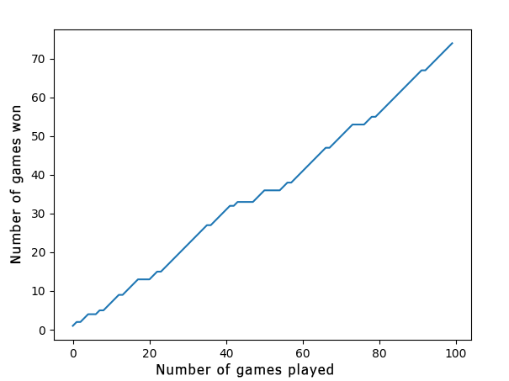
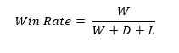
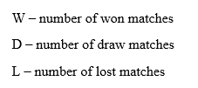
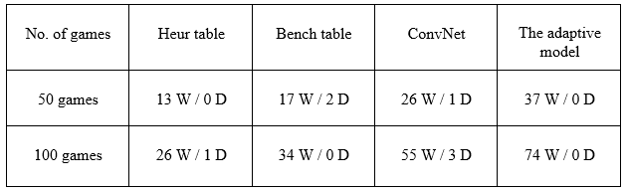
Results
Notes:
When testing the deep learning model, the final accuracy was equal to approximately fifty five percent. This is not the best accuracy for this model, it can be further improved, but the actual win-rate of the model is pretty good considering we combine the both models presented.
In the plot figure presented, the adaptive model won seventy-four games, from the total of one hundred games played, resulting in a win rate equal to seventy-four percent. Our adaptive model succeeded in winning almost three quarters of the games, that is quite good for an adaptive model combined of a deep learning model and a predefined weight tables model.
We can also see that the Heur and Bench tables don’t perform so good when used alone, but by combining them with the deep learning model, we can acquire a better win-rate.

Slide 13
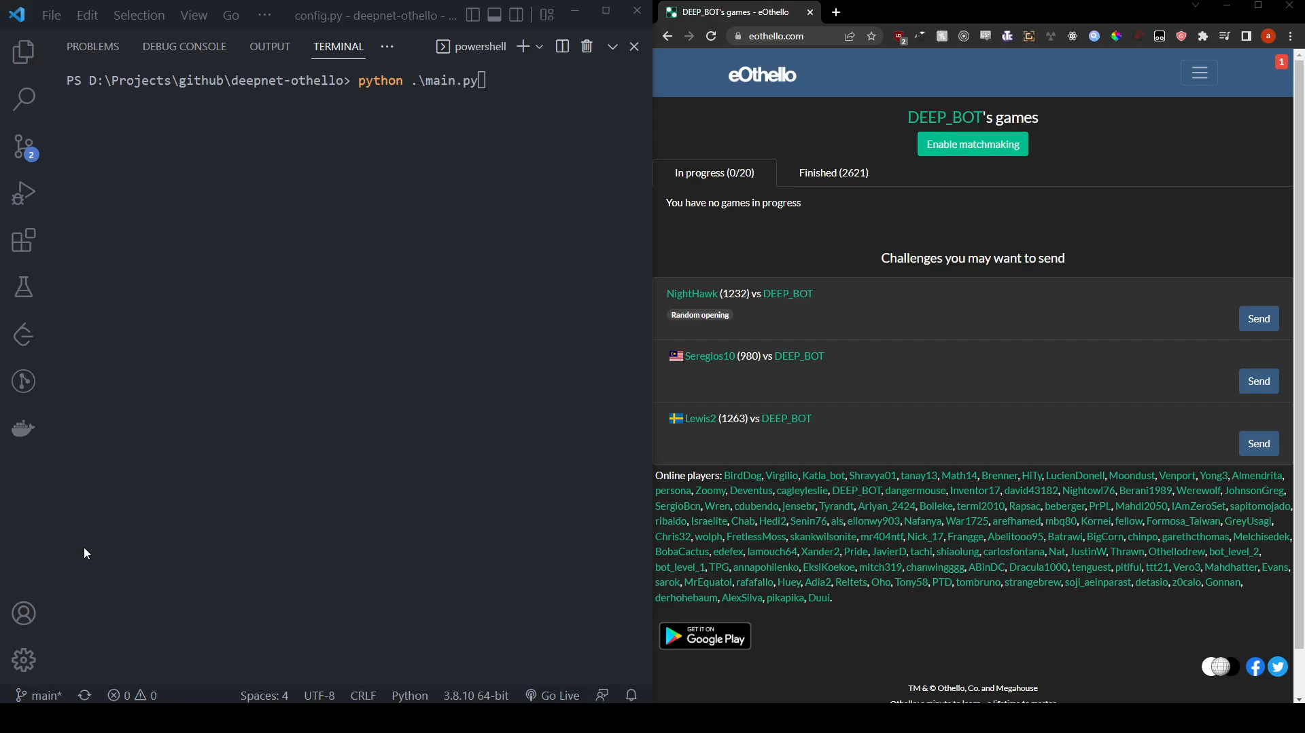
Demo

Slide 14
THANK YOU!
Any questions?

